Slide 1
Day 3 – A Variety of Few-shot Modalities

Slide 2
Day 1 and 2 reminders
Day 1
Intro to few-shot learning
Applying few-shot to new data
Day 2
Training few-shot models
Tips and tricks
Few-shot model types
Metric-based
Meta-learners
Conditioned models

Slide 3
Questions from day 1 and 2?

Slide 4
Encoders vs. Few-Shot Models
Few-Shot Model (e.g. ProtoNets, RCNet)
Combines support and query set
Makes classification decisions
Encoder (e.g. ResNet-50, VGGish, BERT)
Modality specific
Converts raw data to numeric vector
To apply few-shot learning we only need:
Sufficient number of classes to train on
An encoder that converts raw data to vectors
Encoder
Few-Shot Model

Slide 5
Applying to a new modality
This allows us to apply few-shot in new modalities. And (minimally) requires us to modify the following:
Data
Code to load individual datapoints
Any preprocessing functionality
Encoder
An encoder architecture
Preprocessing functionality should match encoder’s expected input

Slide 6
Text Few-shot learning

Slide 7

Recurrent Neural Networks
Fully connected networks with a hidden state
Incorporates information from previous timesteps to maintain context through time.
Many difference variations
Simple Recurrent Neural Network
Long Short-Term Memory
Gated Recurrent Unit

Slide 8
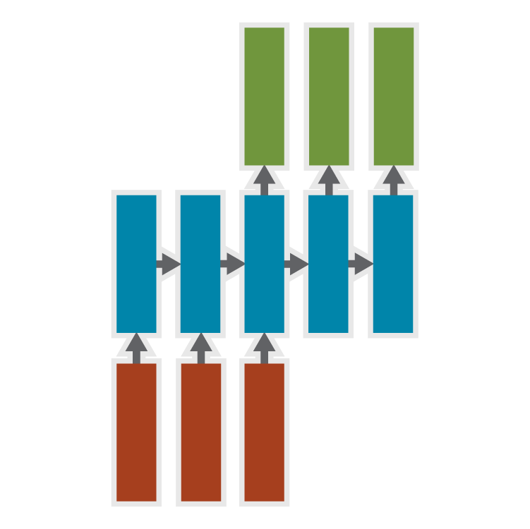
Sequence → Sequence
Seq2Seq
Predict future events from past sequence
Incredibly powerful with attention mechanisms
Example: Machine Translation
Original sentence → Translated sentence
Paraphrase generation
Dialogue generation
Example: Video Forecasting
Beginning of video → Predict what follows
Notes:
Relate to Audio and video, explanation of LSTM?

Slide 9
Transformers
https://talktotransformer.com
Traditional text models use Recurrent Neural Networks (RNNs)
Process text as a sequence
Transformers are an attention-based model
First introduced in 2017
Unprecedented text generation quality https://transformer.huggingface.co/
How should I explain what a transformer is to my colleagues? They're very interested in new developments to Natural Language Processing tasks! You can also explain things very simply using mathematical notation. (It's not necessary.) Transformers are used in a variety of fields. (I'm a professional mathematician myself.) These two are examples of what transformer is in other domains of science, including: In the field of mathematics, we use many different mathematical languages to describe our transformations of numbers into symbols. For instance, to get a symbol from one number to another, we use the "add" function (the number of numbers you add up to get one number). And to get the same symbol, we use the "subtract" function. You can also say that a transformer can produce a symbol based on a particular context, a category, or on the input to the transformer. For example, we can call a transformer any function that takes two variables, a and b, and applies a function f to the first variable only. Thus, the following is a function that takes two variables and applies one function g to the first and the second
Notes:
Changed example URL from https://talktotransformer.com/ to https://transformer.huggingface.co/ as the first has gone to a subscription fee to cover GPU costs.

Slide 10
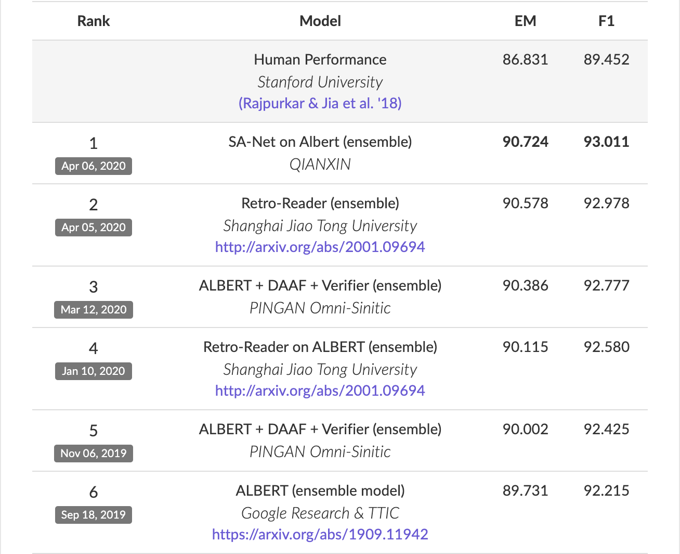
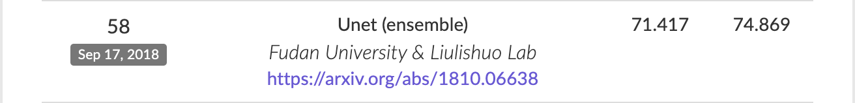
Transformers
Not just for improving text generation
State-of-the-art performance in almost all standard NLP tasks
SQUAD 2.0 leaderboard
Question answering
Pre-transformers
SQuAD 2.0 leaderboard (4/27/2020)

Slide 11
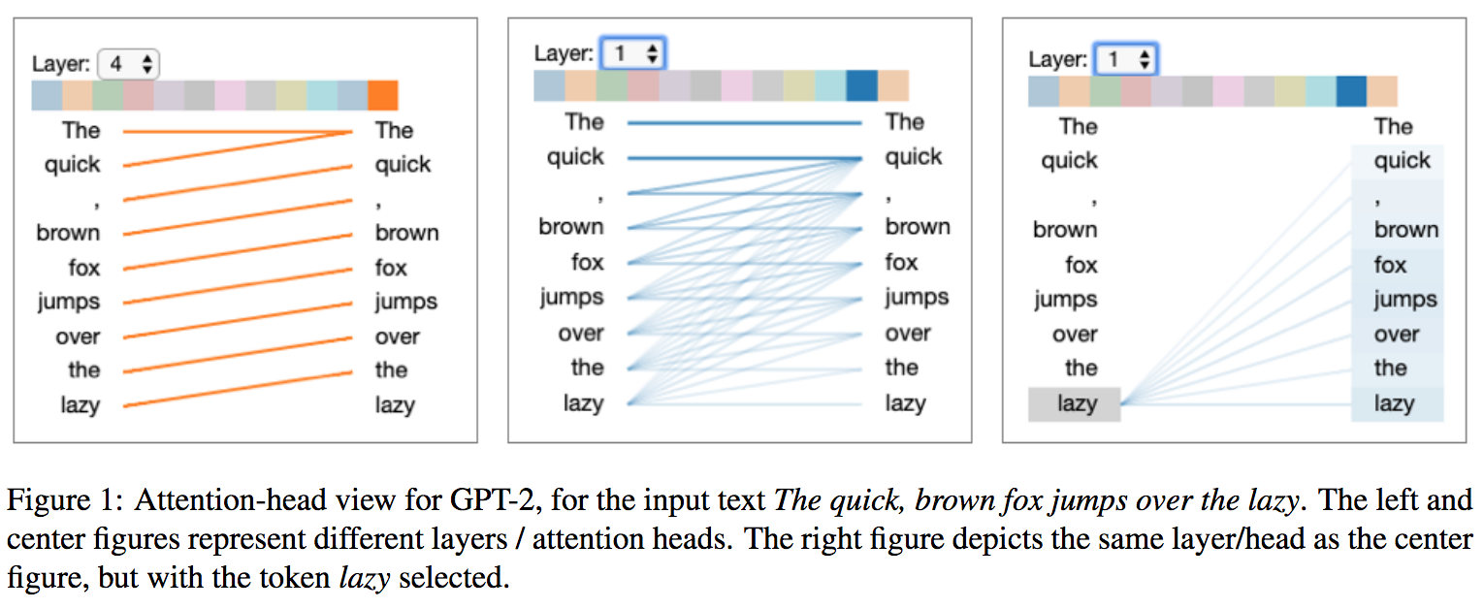
Self-Attention Mechanisms
Allows model to directly connect words from the full sequence, ignoring distance
https://arxiv.org/pdf/1906.05714.pdf

Slide 12
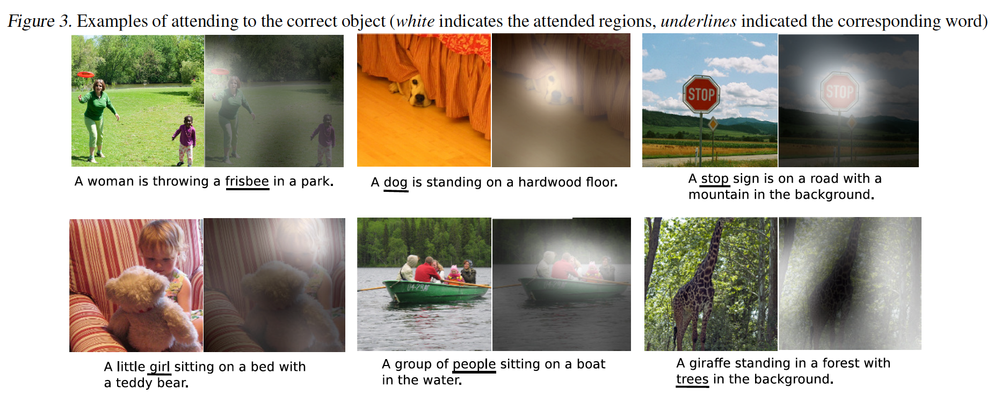
Attention Mechanisms
Attention can act as a window into what a model is “thinking”
The weights that the attention mechanism produces show us how important each value is to the network at that time

Slide 13
Text Few-shot learning
Few-shot generally relies on training with many classes (ideally >100)
But many NLP tasks focus on small sets of classes
Open questions
Can we leverage pre-trained transformers as an encoder?
When talking about 5-shot performance, is 5 examples of text enough? Or should we expect worse performance?

Slide 14
Few-shot Authorship Attribution
Authorship attribution
Many potential classes (i.e. authors)
Very challenging problem requiring large data...
Could few-shot even be applied?
Goals:
Assess viability
How much data is enough?
What techniques from traditional authorship ID can be applied (e.g. stylometrics?)

Slide 15

Reddit Comment Authorship
Reddit is a social media website where users can comment on posts
One month of comment history collected from pushshift.io
From the most-commented 10K subreddits, identified top 10K users
Removed known bot accounts (AutoModerator, ****Bot)
 | Train | Val | Test
# authors | 7977 | 917 | 1007
Avg # posts/author | 1018 | 917 | 1003
Avg # chars/post | 175 | 147 | 165

Slide 16
Stylometrics
Features intended to capture how a person writes, rather than the topics they choose to write about
Stylistic
Punctuation usage, sentence length, upper/lowercase, whitespace
Character n-grams
10,000 features, computed over training dataset
Syntactic
POS tags, POS n-grams calculated with Tweet NLP (Owoputi et al., 2013)
Lexical
Normalized function word counts

Slide 17
Text feature encoders
Late Fusion concatenates separate feature types
N-gram features are represented as embeddings
Non-n-gram features processed through 4-layer MLP with ReLU activations
Few-shot Model

Slide 18
Results – Stylometric comparison
Feature Types | Test Acc.
Stylistic | 52.4%
N-grams | 33.4%
Syntactic | 47.1%
Lexical | 31.2%
DistilBERT | 70.6%
Style + Lex | 52.3%
Style + Lex + Syn | 58.2%
All Stylometrics | 57.4%
All + DistilBERT | 72.2%
5-shot, 5-way
Choose from 5 different authors
5 comments per author
Of individual features, DistilBERT performs best, but may be focusing on “topic” rather than identity
Stylistic features perform best in combination
Notes:
LAP: Update numbers

Slide 19
Results – Increasing k-shot
How does performance scale with increased data?
Slight improvements (3-4%pts) for all models
Is DistilBERT just focusing on topic?
Easy set is 200 users who comment on least diverse set of subreddits
Hard set is 200 users who comment on most diverse set of subreddits
 | 5-shot | 10-shot | 20-shot
DistilBERT | 70.01% | 72.19% | 74.13%
All Stylometrics | 43.10% | 44.41% | 46.20%
All + DistilBERT | 70.19% | 72.32% | 74.15%
 | Easy | Hard
DistilBERT | 83.2% | 61.3%
All Stylometrics | 67.3% | 52.0%
All + DistilBERT | 83.8% | 61.8%
Notes:
Results here are slightly older than the ones on the previous slide, but demonstrate the point

Slide 20
Video Few-shot learning

Slide 21
Video Few-shot learning
A few preprocessing considerations.
Target framerate?
Target height and width?
Optical flow?
Videos can quickly consume too much memory.
Low framerates (1-5 fps) can be helpful concessions to make.
Loading entire episodes of data can be time-consuming.
Necessitates loading preprocessed data (at least for training)
Once loaded, the goal is to classify query videos (frame sequences).

Slide 22
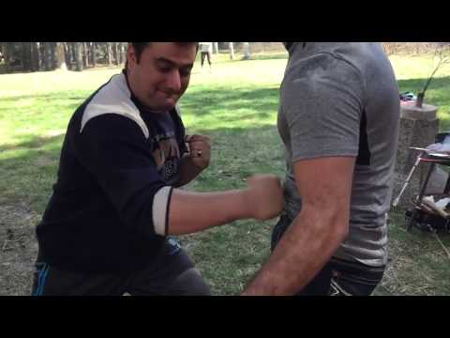
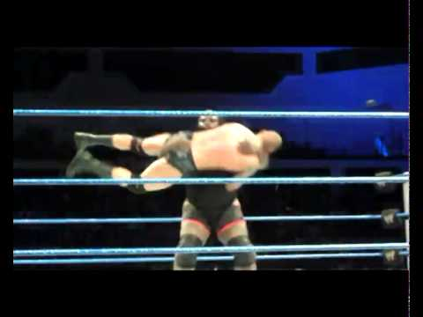
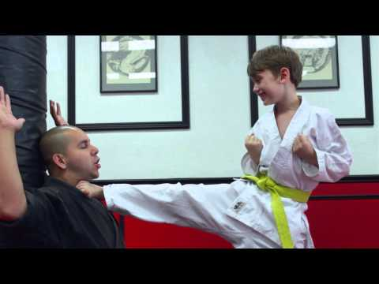
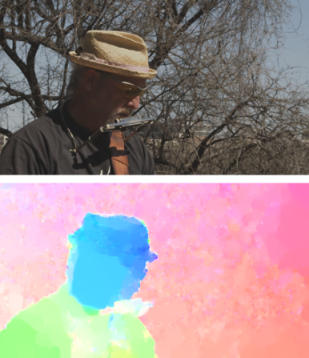
Few-Shot Kinetics Data
Subset of the Kinetics dataset (10-second YouTube clips)
Kinetics 600
600 actions, at least 600 examples per action
Provides more examples / allows for “challenge set”
General test: standard, randomly sampled classes
Challenge test: “aggressive action” set (wrestling, headbutting, smashing, tackling, etc.)
Kinetics 400
Few-shot splits from (Zhu and Yang, 2018)
Less data, no challenge set.
Allows for comparison to state-of-the-art.
Extract RGB and optical flow.

Slide 23
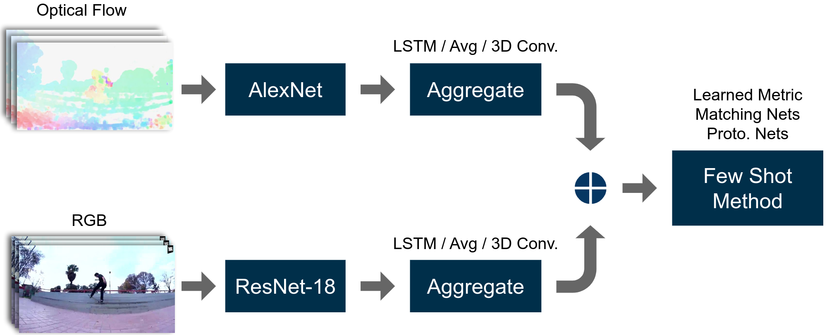
Video Model Architecture
CNN Architectures:
AlexNet, ResNet18, ResNet34
Applied to each frame of the video.
Aggregation:
Avg. Pooling, LSTM, 3D-Convolutions.
Combine frame embeddings over time.
Few-shot method:
Prototypical Nets, Matching Nets, Relation Net.
All simple and similar, ProtoNets outperforms others.
“Two-stream” when using RBG + Flow, “one-stream” using just RGB

Slide 24
Experimental Results
Kinetics 600
After a thorough model search, LSTM or averaging, with prototypical nets yield best results.
Flow improves performance by 2%.
Challenge test set involves non-random split
Train on ”non-violent” actions.
Test on “violent” actions
Kinetics 400
More difficult dataset, due to less data.
Pre-training yields substantial boost.
Input​ | Encoder​ | General Test​ | Challenge Test​
RGB (1 fps)​ | One-Stream, LSTM​ | 82.7​ | 58.0
RGB + Flow ​ | Two-Stream, LSTM​ | 84.2​ | 59.4​
Method​ | CNN​ | Acc
Baseline: CMN | RN-50​ | 78.9​
Baseline: TAM (SOTA)​ | RN-50​ | 85.8​
Two-Stream + LSTM​ | RN-34 + RN-18 | 78.6
Two-Stream + LSTM (PT)​ | RN-34 + RN-18​ | 86.7​

Slide 25
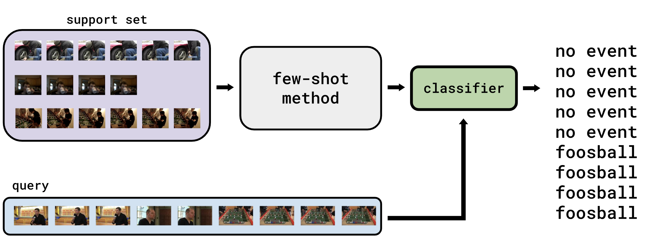
Localization
Moving beyond short videos, can we identify where in a sequence an action is taking place?
Window-based prediction cuts long sequence into manageable chunks

Slide 26
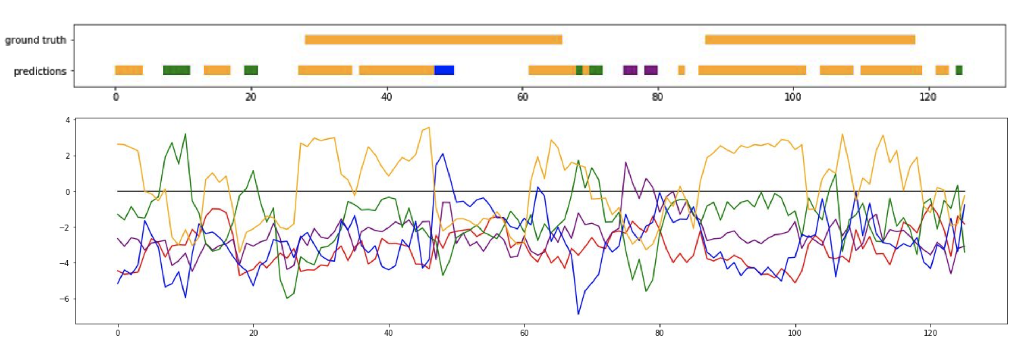
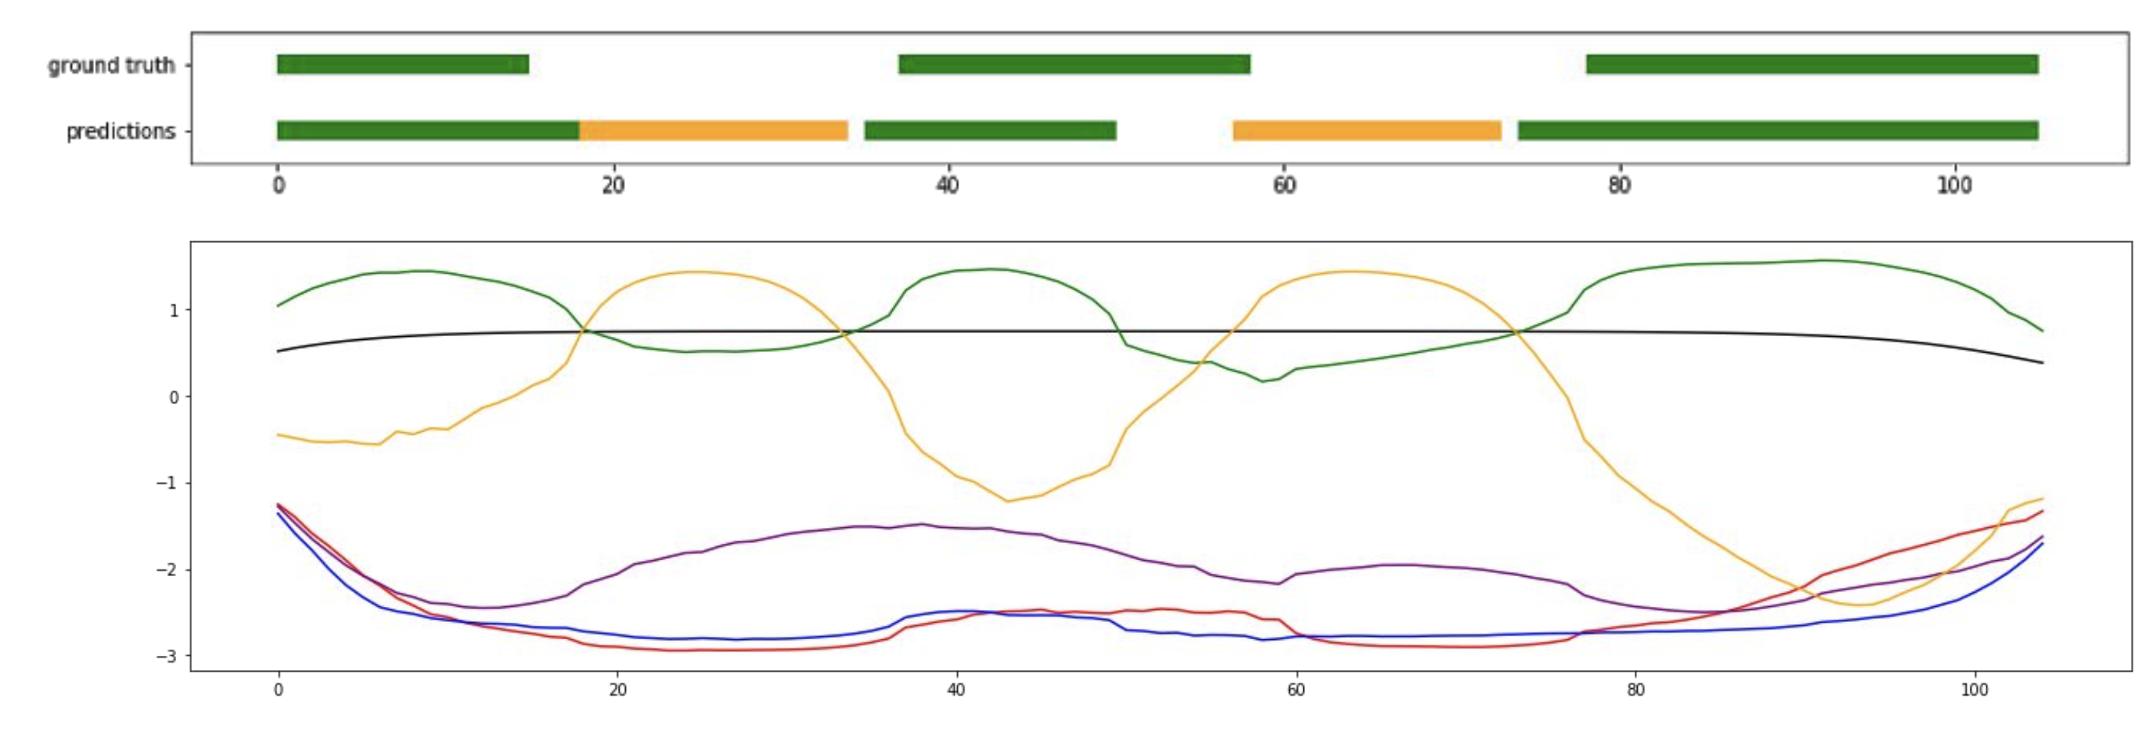
Localization
Challenge is predictions can be very noisy, so smoothing is required

Slide 27
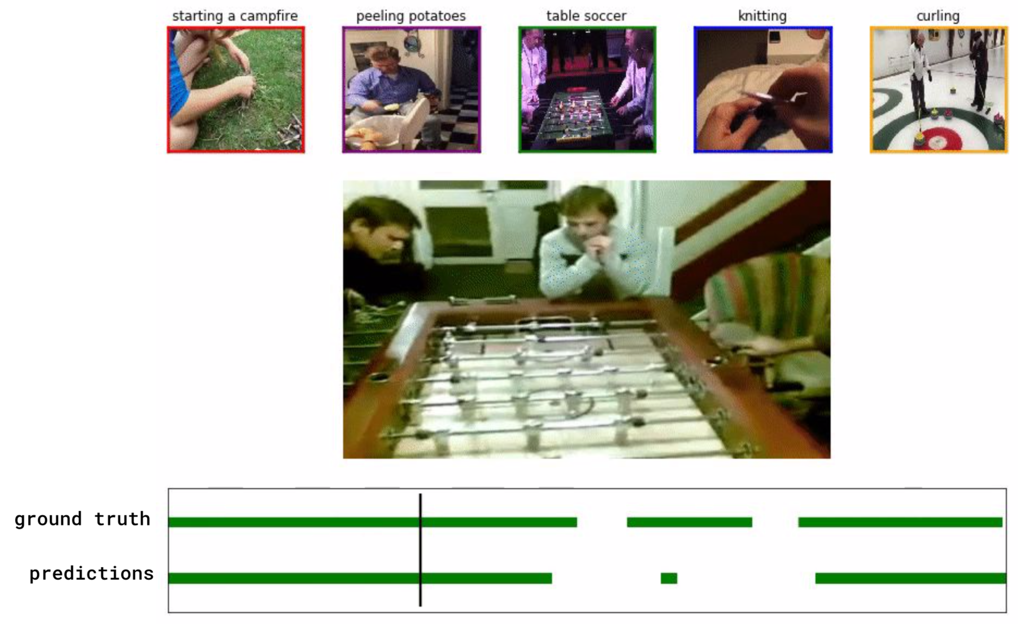
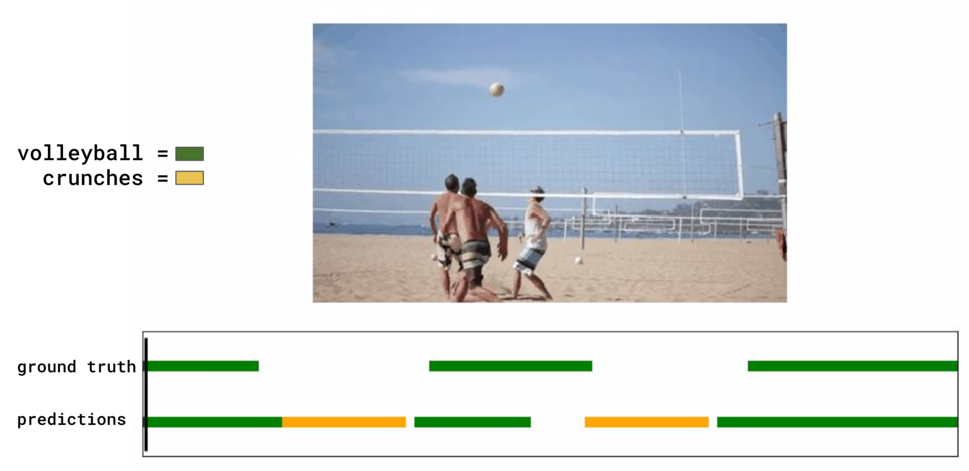
Video - Localization

Slide 28
Audio Few-shot learning

Slide 29
Audio Few-Shot Learning
Multiple parameters for preprocessing audio.
Sample rate?
Length of processing windows?
How much do processing windows overlap?
Might need to chunk up large audio sequences to save memory.
For short clips (~30 sec), we can frequently process them all at once.
Once processed, audio and video can be handled classified in similar fashion
E.g. Localization

Slide 30
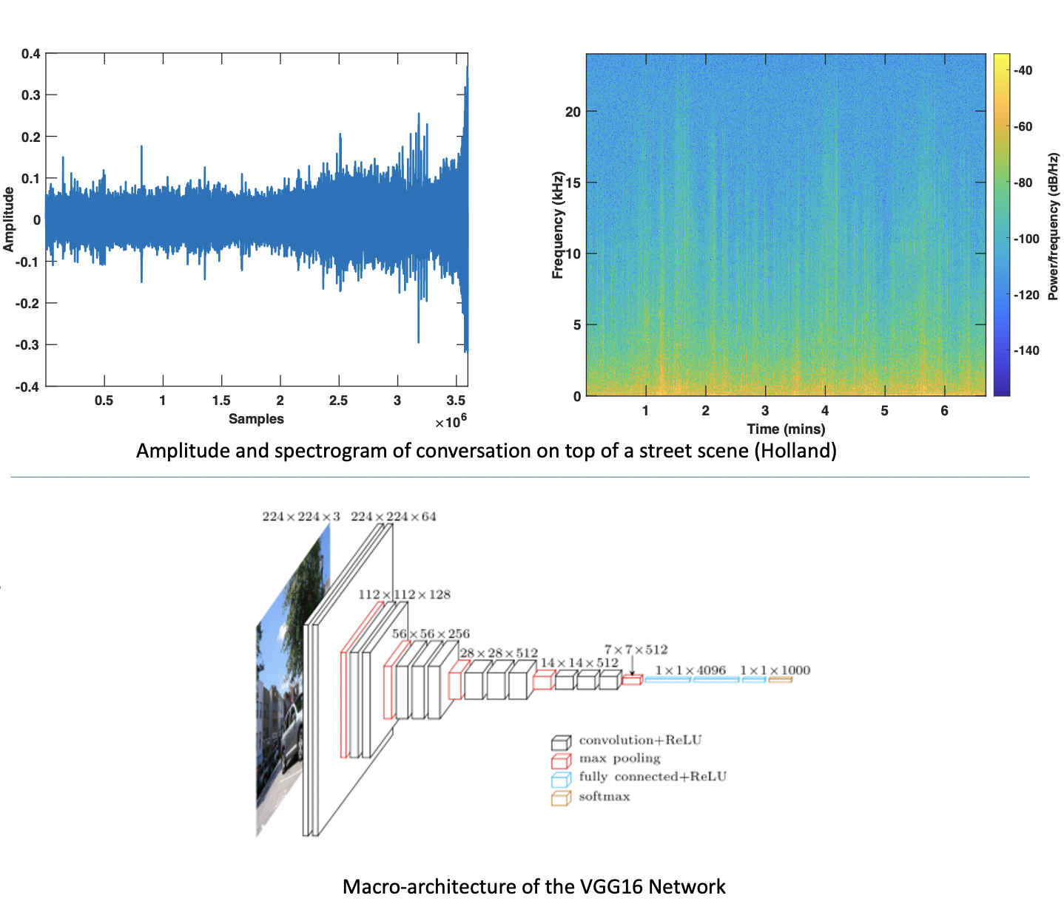
Audio Few-Shot Learning
Processing audio clips relies on transforming raw signals into Mel-Spectrogram representations.
CNNs then operate on the spectrogram images.

Slide 31
Audio – Speaker Identification
VoxCeleb speaker identification
Near 80% accuracy from a single 30-second clip
Without any additional training, up to 66% accuracy on ICSI meeting corpus
Long audio clips with multiple speakers
1-shot / 5-way | 5-shot / 5-way
79.9% | 93.5%
# speakers | 4 | 5 | 6 | 7 | 8 | 9
Avg. Acc. | 66.4% | 54.0% | 56.5% | 53.1% | 59.3% | 36.9%

Slide 32
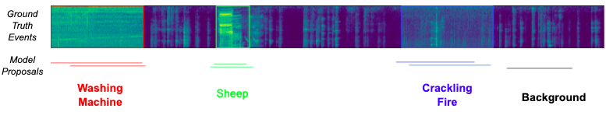
Audio – Audio Event Detection
Kinetics: Same as video experiments, but relying solely on audio clues
HACS temporal action localization
Identify when action is taking place based on audio
0.4 mean average precision (mAP)
1-shot / 5-way | 5-shot / 5-way
35.3% | 51.5%

Slide 33
Few-shot Localization Tasks

Slide 34
Few-shot Localization Tasks
For many problems, knowing where an entity is can be as crucial as what it is.
Disambiguates images with many entities of the same class.
Avoids scrubbing through video to find a potential event of interest.
Or listening to long audio files!
Few-shot learning was already a hard problem!
We're adding a whole new dimension in the same, small-data regime.
Labeling can also be harder: we need location and class label.

Slide 35
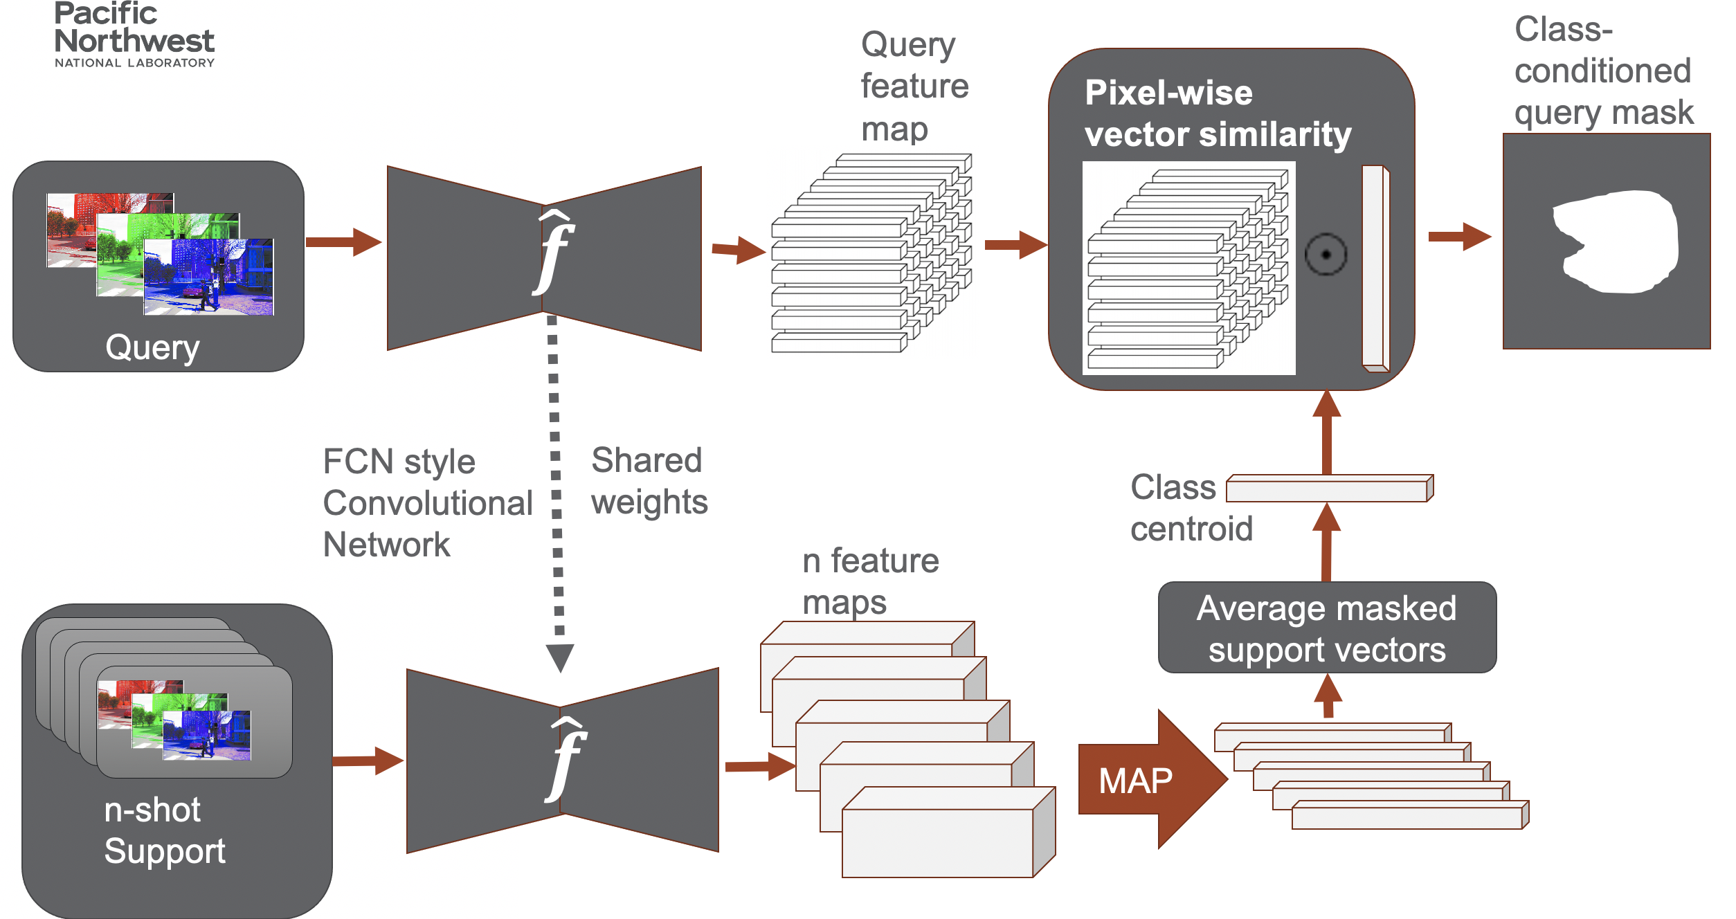
Few-shot Localization Tasks: Image

Slide 36
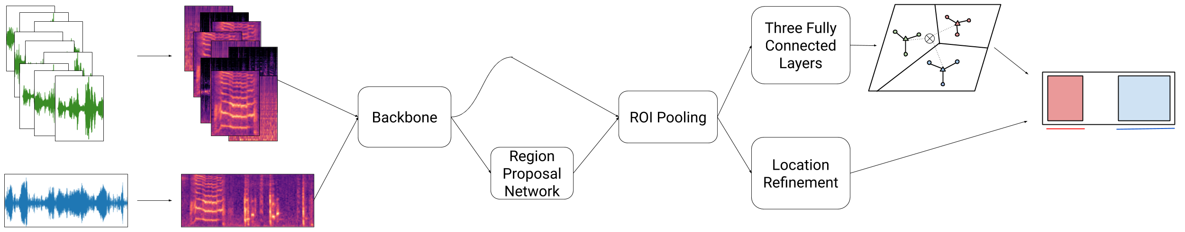
Few-shot Localization Tasks: Audio / Video
Localization can be integrated with a typical event detection framework.
Video or audio "frames" are encoded with a spatiotemporal backbone.
Predict start and end times for event proposals.
Proposals of interest are transformed to a fixed size.
Perform few-shot classification on proposals of interest.

Slide 37
Some Extensions to Few-shot

Slide 38
None-of-the-above, or “Distractors”
In practice, real-world datasets are made up of individual datapoints that may belong to any number of possible classes
In many cases it will be impossible to assign every datapoint to a class
Or some classes may just not be very interesting and we’d like to ignore
Many few-shot models lack the ability to place a datapoint into no class
E.g. ProtoNets inherently assigns all data to a class
This is a substantial limitation, especially when applying few-shot models to user interfaces

Slide 39
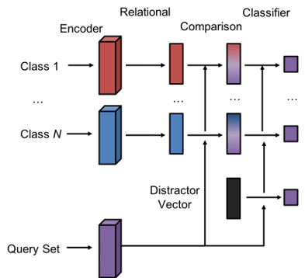
Solutions to Distractors
RCNet solves this problem by creating a vector to represent the distractor class
Distractors are still somewhat more difficult than other datapoints
RCNet distractor performance
Precision = 0.79
Recall = 0.69
Overall acc. = 0.88

Slide 40
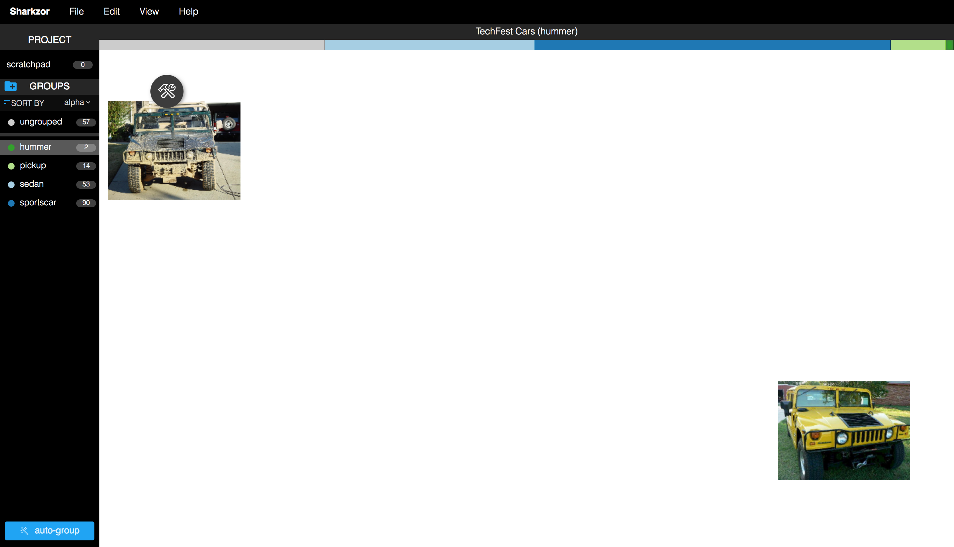
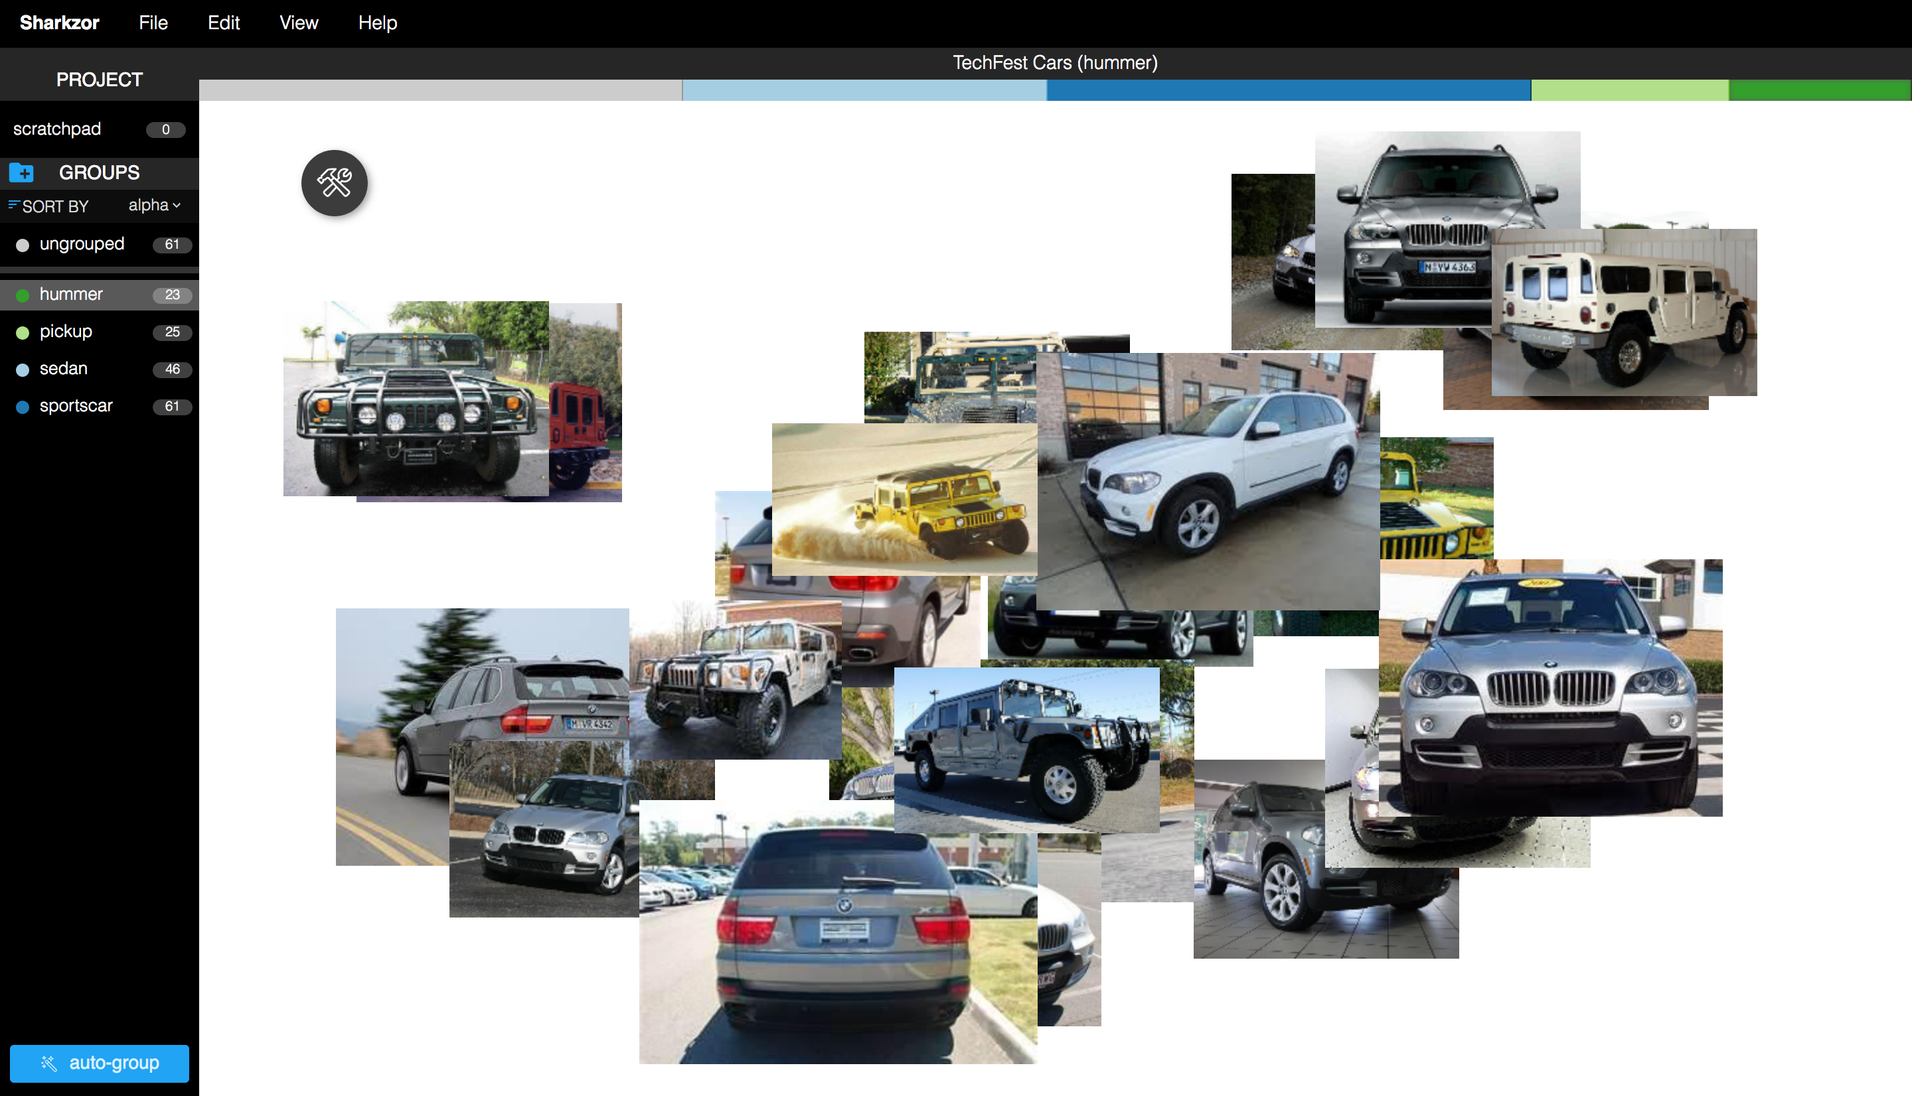
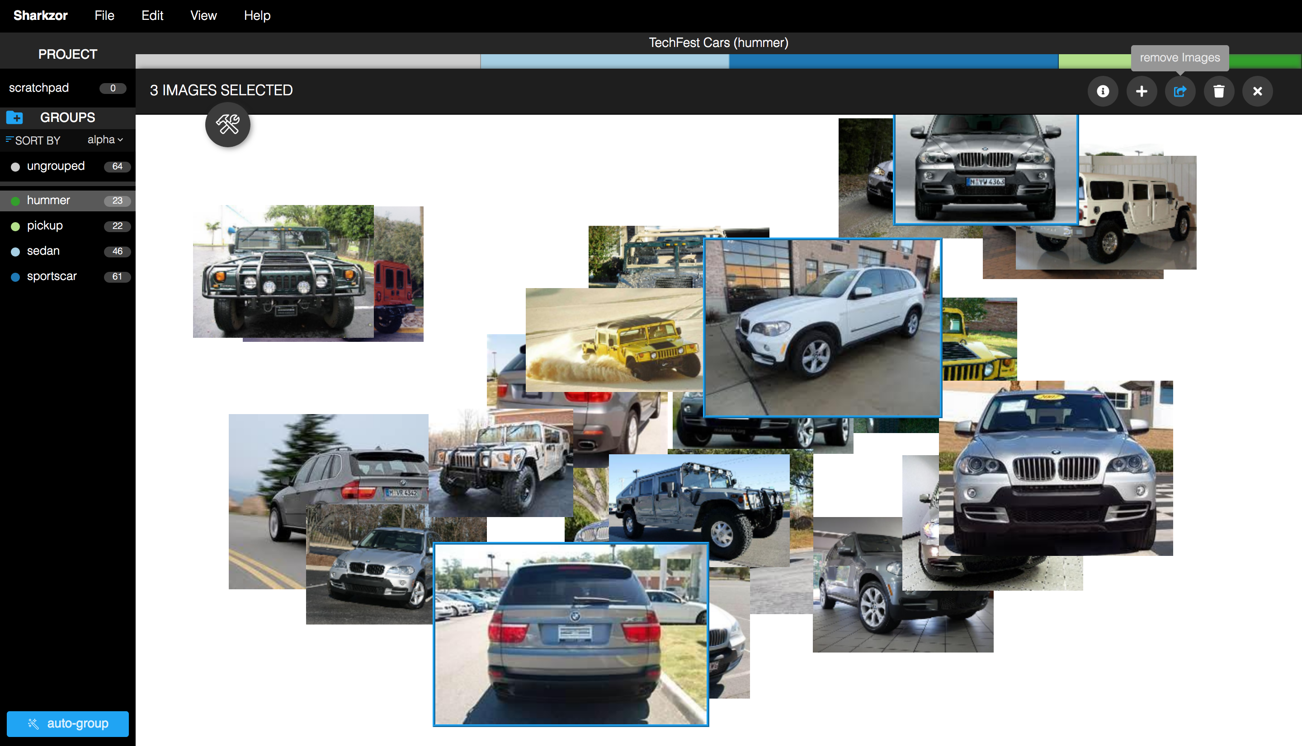
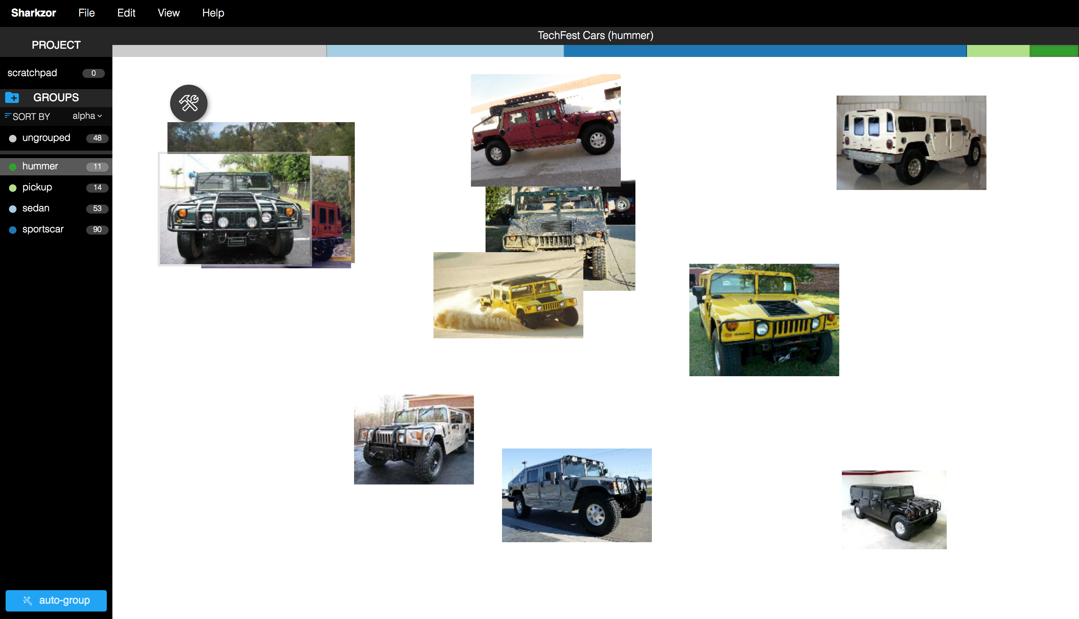

Mistakes as Negative Examples
User provides positive examples
Model makes decisions
User corrects model mistakes
Model makes decisions incorporating feedback
Notes:
Update accuracy numbers

Slide 41
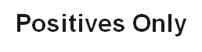
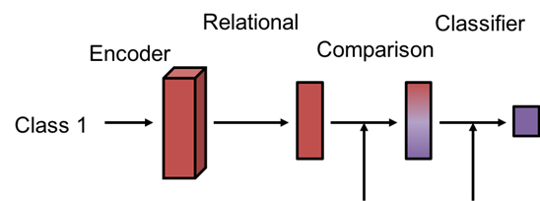
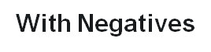
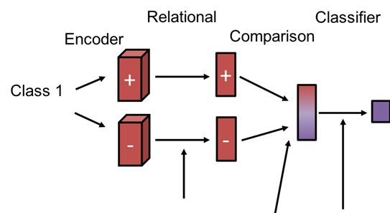
Negative examples
Negative examples should inform what a class doesn’t look like
Relational network looks for similarity between queries and negatives
To train the model, we train each episode twice
Once with only positives
Then a second time with negatives as well

Slide 42
Day 3 Practical

Slide 43
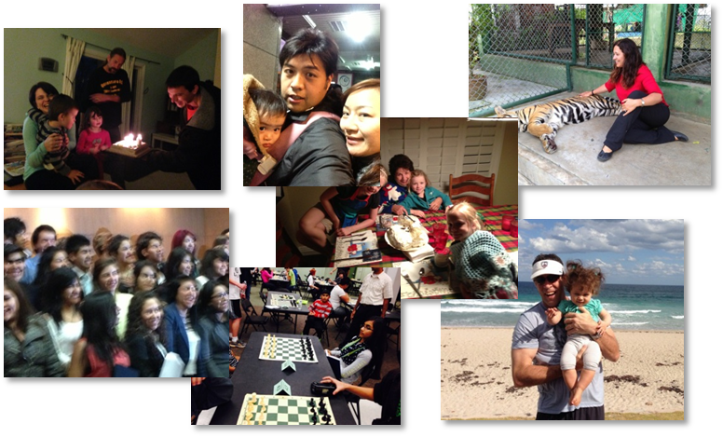
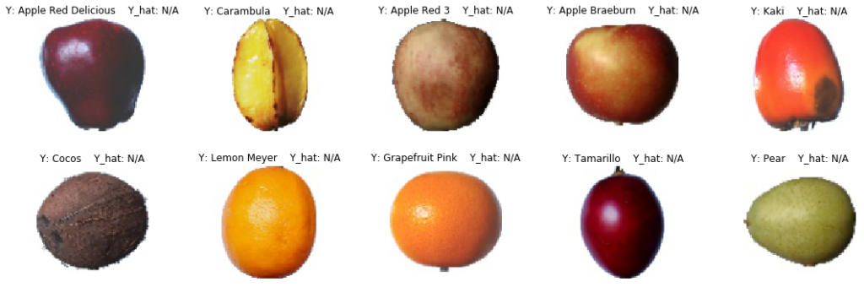
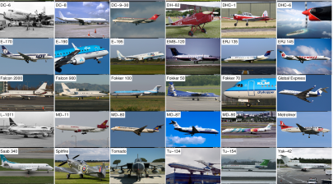
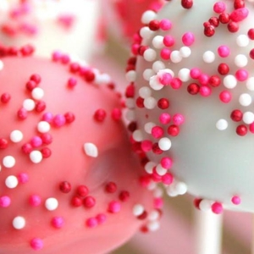
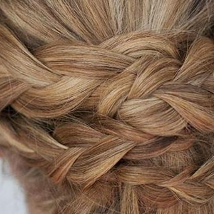
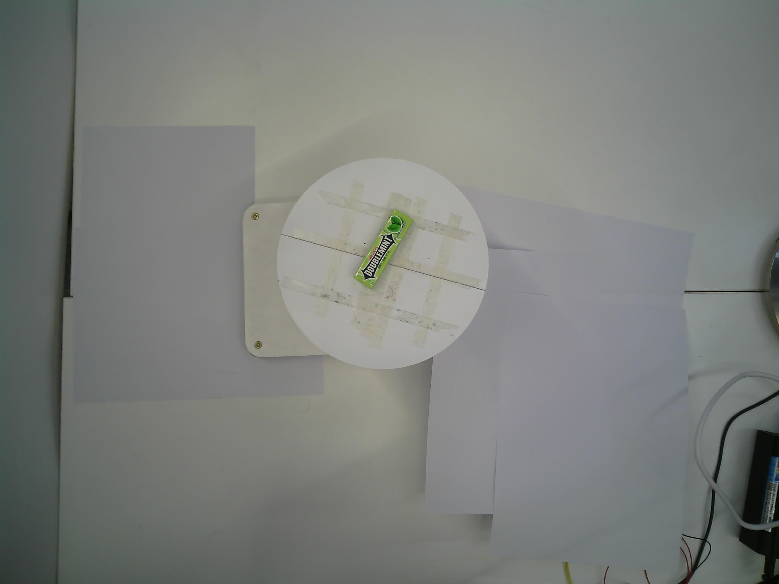
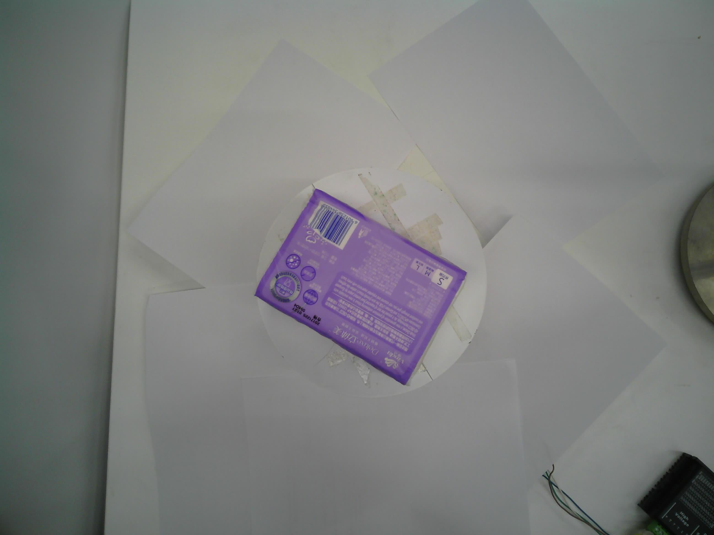


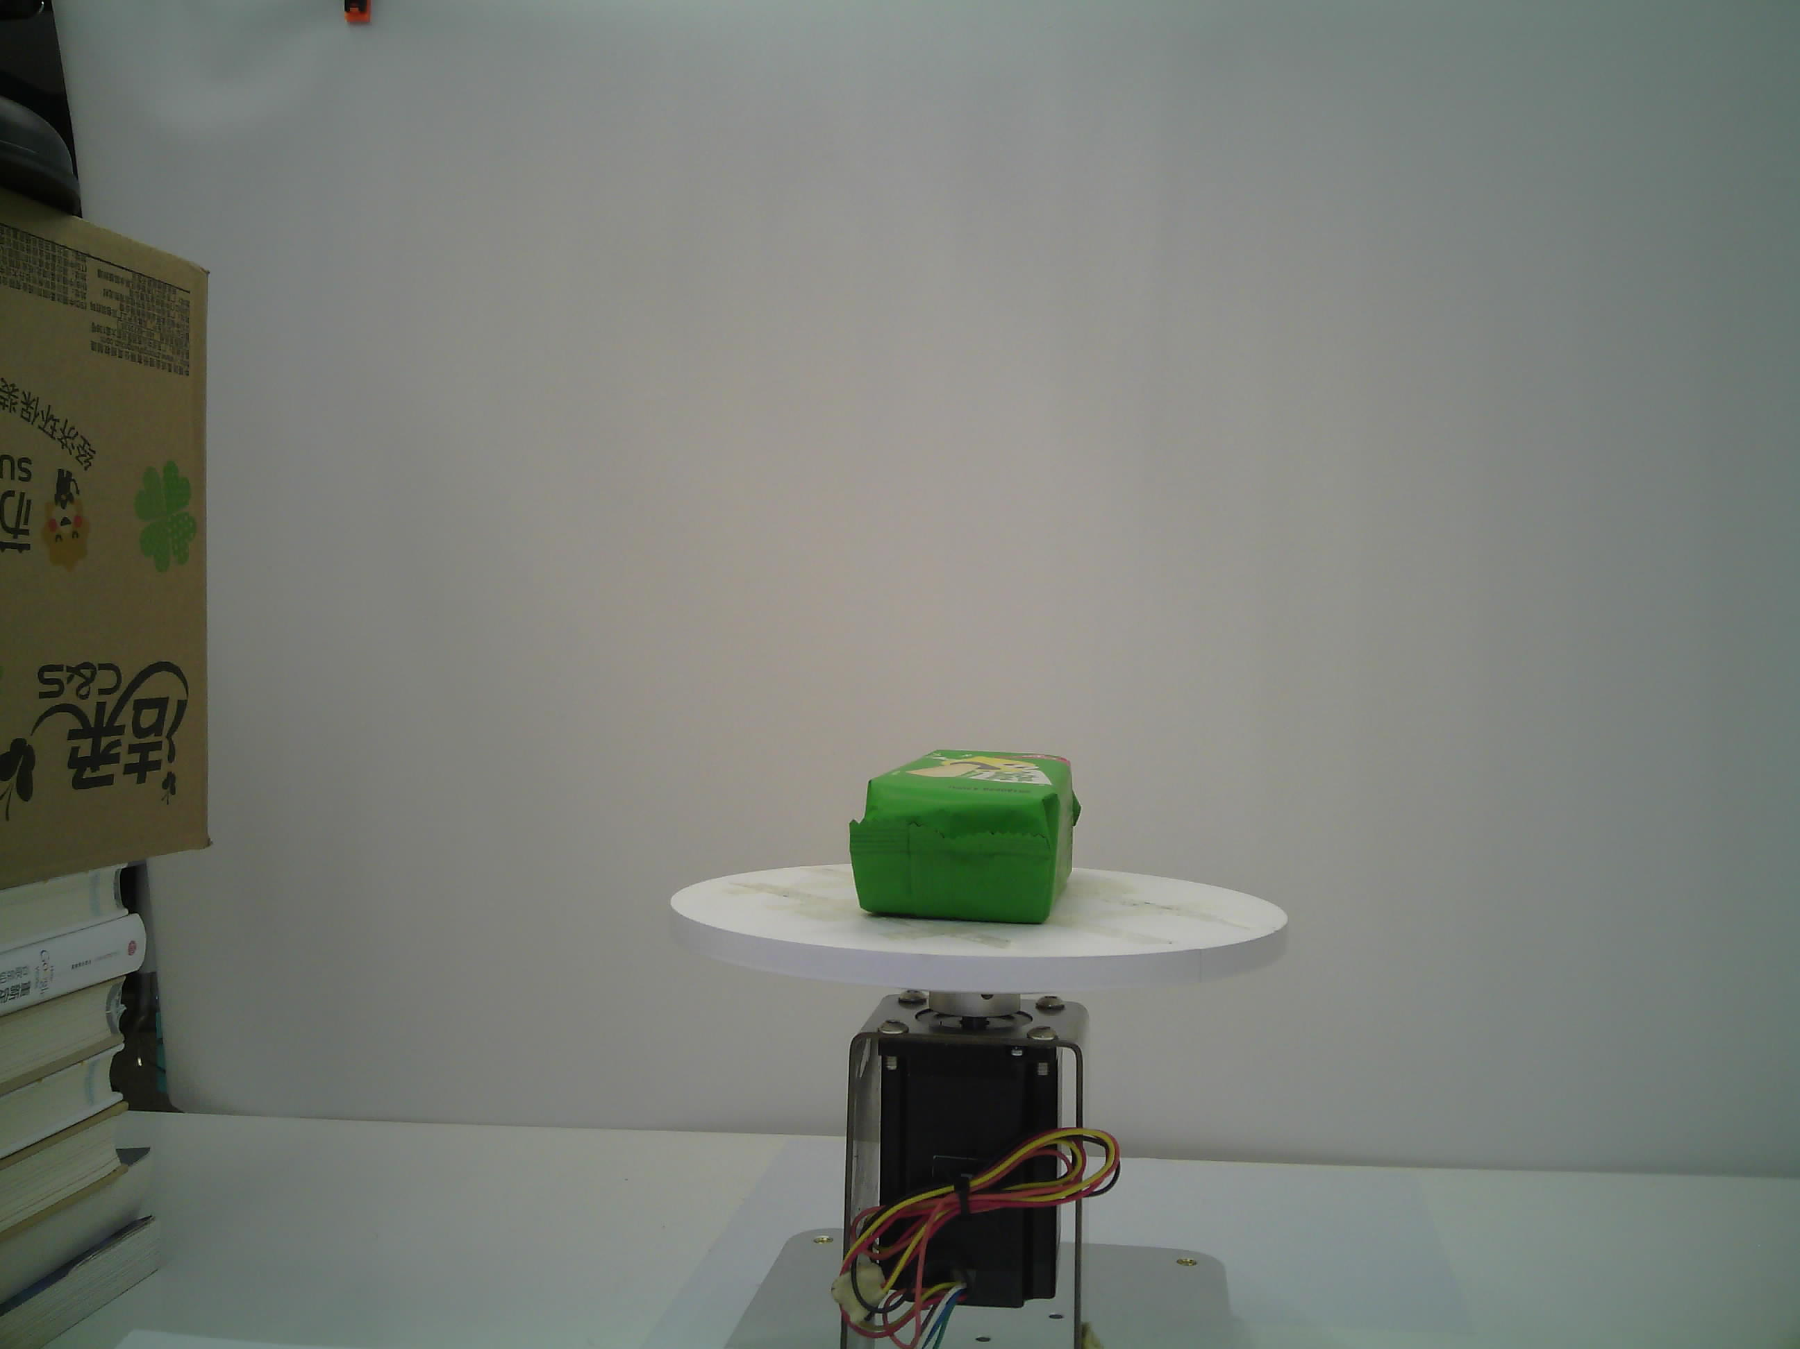
Baseline Datasets
A few pictures highlighting the variety of images in the datasets

Slide 44
Baseline Takeaways
Baseline Experiments - produced experiments on a wide variety of datasets to get a better snapshot of how well models generalize to new data
Baseline pipeline - standardized the addition of new datasets to the pipeline so we can continue to add new datasets with minimal effort

